Slide 1
Singleton
Fahim Farook

Slide 2
Agenda
Different implementations of Singleton
Problems with Singleton and solutions
Reflexion attacks
Breaks SRP
Global State Problem

Slide 3
What is Singleton

Slide 4
Implementing a Singleton
Lazy Initialization
static Singleton instance;
public static synchronized Singleton getInstance() {
if (instance == null)
instance == new Singleton();
return instance;
}

Slide 5
Lazy Initialization - Double-Checked Locking idiom
static volatile Singleton instance;
public static Singleton getInstance() {
if (instance == null) {
synchronized (Singleton.class) {
if (instance == null)
instance == new Singleton();
}
}
return instance;
}
Check a volatile field in the common path and only synchronize when necessary

Slide 6
Eager Initialization
// Singleton with public final field
public class Elvis {
public static final Elvis INSTANCE = new Elvis();
private Elvis() { ... }
// .....
}
NO flexibility to change your mind whether the class should be a singleton, without changing its API.

Slide 7
Eager Initialization – Factory Method
// Singleton with static factory
public class Elvis {
private static final Elvis INSTANCE = new Elvis();
private Elvis() { ... }
public static Elvis getInstance() {
return INSTANCE;
}
//....
}
Could easily be modified to return a unique instance for each thread that invokes it.

Slide 8
Serializable Singletons
Just implement Serializable? No...
// readResolve method to preserve singleton property
private Object readResolve() {
// Return the one true Singleton and
// let the garbage collector to take care of
// the Singleton impersonator.
return INSTANCE;
}

Slide 9
Reflection Attacks
Singleton instance1 = Singleton.getInstance();
Class cl = Class.forName("Singleton");
java.lang.reflect.Constructor[] c= cl.getDeclaredConstructors();
c[0].setAccessible(true);
Singleton instance2 = (Singleton) c[0].newInstance();

Slide 10
The enum implementation
// Enum singleton - the preferred approach
public enum Elvis {
INSTANCE;
//...
}
Concise
Provides the serialization machinery for free
Reflection attacks cannot break Singleton-ness

Slide 11
Single Responsibility Principal
SRP states that a class should have one and only one responsibility
A Singleton, by it's very nature, has at least two responsibilities
It's primary function
To ensure that only one instance be created
Brakes SRS

Slide 12
Singleton to follow SRP
// Make sure single object is created
public class Singularizer { private Singularizer() {} public static NonSingleton ns =
new NonSingleton(new Singularizer()); }
// Can’t initialize without a Singularizer
// Do my ONE task only public class NonSingleton { public NonSingleton(Singularizer s) { assert(s != null); } }

Slide 13
Global State Problem

Slide 14
What is Global State?
Global variables which provide global access
#include <stdio.h> static int shared = 3; extern int overShared = 1; int overSharedToo = 2; void test_global_property(void) {
int nonGlobal = 99; shared = 0; overShared = 0; overSharedToo = 0; }
Java [doesn’t] have global variables????

Slide 15
Singletons are Global
According to GoF, Singleton has 2 properties
Single instance per JVM
Provide global access to the single instance
// From anywhere of your code
Singleton.getInstance().doSomething();
A Singleton is Global State in Sheep’s Clothing

Slide 16
Global State is Bad
Global State is Bad, and so Singletons
Most software engineers will agree that Global State is undesirable. However, a Singleton creates Global State, yet so many people still use that in new code.

Slide 17
Undesirable effects of Singletons/ Global State
Makes unit testing difficult
Makes APIs lie about their dependencies
Transitive “Global Load”
Singleton in a dependent library

Slide 18
Undesirable effects of Singletons/ Global State
Makes unit testing difficult
Makes APIs lie about their dependencies
Transitive “Global Load”
Singleton in a dependent library

Slide 19
1. Singleton makes unit testing difficult
When running test suites, global state mutated in one test can cause a subsequent or parallel test to fail unexpectedly
Global state often prevents tests from being able to run in parallel, which forces test suites to run slower
If you add a new test (which doesn’t clean up global state) and it runs in the middle of the suite, another test may fail that runs after it

Slide 20
Properties of unit test cases
No external state enters the test (there is no external object passed into the tests constructor or test method).
No state leaves the tests (the test methods are void, returning nothing).
When an ideal test completes, all state related to that test disappears. This makes tests isolated and all of the objects it created are subject to garbage collection
Possibility to run tests in parallel or in any order

Slide 21

However, when global state/singletons are present all of these nice assumptions breakdown.
State can enter and leave the tests and it is not garbage collected. This makes the order of tests matter. You cannot run the tests in parallel

Slide 22
Symptoms of presence of Singletons
Tests fail when run in a suite, but pass individually or vice versa
Tests fail if you change the order of execution
Some already written tests fail if you introduce new test cases
Classes define initializeForTest(…), uninitialize(…), and other resetting methods

Slide 23
How Singleton makes UT impossible?
Isolation of the class under test is achieved by wiring the dependencies with mocks which replace the real dependencies.
Seams work through polymorphism, we override/implement class/interface and then wire the class under test differently in order to take control of the execution flow.
With static methods there is nothing to override

Slide 24
Singleton are not Polymorphic
The constructor is private so we can't extend
The getInstance is static so it's not possible to override it in order to inject a fake instead of the singleton object → for unit testing the class that uses singleton
For mocking frameworks based on inheritance and polymorphism, Singleton is obviously a big issue.

Slide 25
public class Customer {
public int caculateDiscount() {
MySingleton singleton = MySingleton.getInstance();
String something = singleton.getSomething();
// use ‘something’ here
return ...;
}
}

Slide 26
public class CustomerTest {
@Before
public void resetMySingleton() throws Exception {
Field instance = MySingleton.class.getDeclaredField("instance");
instance.setAccessible(true);
instance.set(null, null);
}
@Test
public void theDiscountShouldBe5PercentWhenSomethingOccurs() {
// Test logic specific to the Customer
}
}

Slide 27
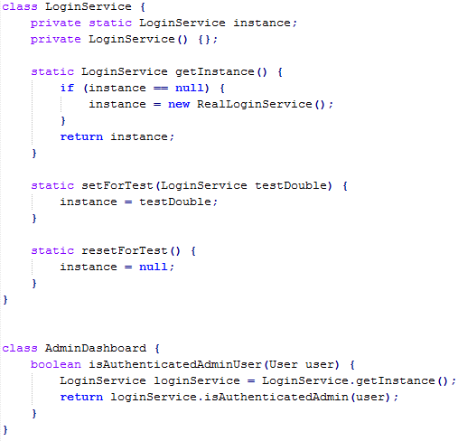
or else...
Remove final from instance
Provide setForTest/ resetForTest

Slide 28
// Trying to write a test is painful!
class AdminDashboardTest extends TestCase {
public void testForcedToUseRealLoginService() {
// ...
assertTrue(adminDashboard.isAuthenticatedAdminUser(user));
// ☹! Because of the Singleton,
// forced to use the RealLoginService()
// Or forced to use setForTest()/ reset()
// methods breaking Singleton-ness
}
}

Slide 29
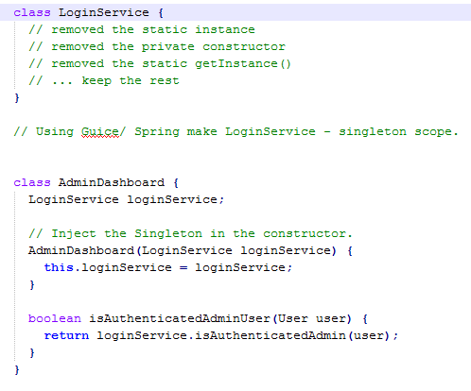
Fix

Slide 30
class AdminDashboardTest extends TestCase {
public void testUsingMockLoginService() {
// Testing is now easy, we just pass in a test-double
// LoginService in the constructor.
AdminDashboard dashboard =
new AdminDashboard( Mock(LoginService.class) );
// ... now all the tests will be small and fast
}
}

Slide 31
Making a class a singleton can make it difficult to test its clients, as it’s impossible to substitute a mock implementation for a singleton unless it implements an interface that serves as its type.
– Effective Java

Slide 32
“The problem with using a Singleton is that it introduces a certain amount of coupling into a system — coupling that is almost always unnecessary. You are saying that your class can only collaborate with one particular implementation of a set of methods — the implementation that the Singleton provides. You will allow no substitutes. This makes it difficult to test your class in isolation from the Singleton. The very nature of test isolation assumes the ability to substitute alternative implementations… for an object’s collaborators. … [U]nless you change your design, you are forced to rely on the correct behavior of the Singleton in order to test any of its clients.”
[J.B. Rainsberger, Junit Recipes, Recipe 14.4]

Slide 33
Undesirable effects of Singletons/ Global State
Makes unit testing difficult
Makes APIs lie about their dependencies
Transitive “Global Load”
Singleton in a dependent library

Slide 34
2. Global State / Singletons make APIs lie about their true dependencies
To really understand the dependencies, developers must read every line of code
Hidden dependency between A and B
A
Singleton.getInstance().
changeSomething();
B
Singleton.getInstance().
getThatThing();

Slide 35
The root problem with global state is that it is globally accessible. In an ideal world, an object should be able to interact only with other objects which were directly passed into it (through a constructor, or method call).

Slide 36
Suppose CreditCard class has a dependency to a Singleton
testCreditCardCharge() {
CreditCard = new CreditCard("1234", "01/11");
assertTrue(card.charge(100));
// but this test might fail at runtime!
}

Slide 37
testActionAtADistanceWithInitializtion() {
// Global state needs to get set up first
Database.init("dbURL", "user", "password");
CreditCardProcessor.init("http://uri", "security key", "vendor");
CreditCard = new CreditCard(“1234", "01/11");
assertTrue(card.charge(100));
// but this test still fails!
}

Slide 38
By looking at the API of CreditCard, there is no way to know the global state you have to initialize. Even looking at the source code of CreditCard will not tell you which initialization method to call. At best, you can find the global variable being accessed and from there try to guess how to initialize it.

Slide 39
How to Fix
Singletons/ Global states are the problem
Remove hidden dependencies/ singletons → provide dependencies/ collaborators in the constructor
testUsingDependencyInjectedObjects() {
Database db = new Database("dbURL", "user", "password");
CreditCardProcessor processor = new CreditCardProcessor(db, “url", "key");
CreditCard = new CreditCard(processor, “1234", "01/11");
assertTrue(card.charge(100));
}

Slide 40
Undesirable effects of Singletons/ Global State
Makes unit testing difficult
Makes APIs lie about their dependencies
Transitive “Global Load”
Singleton in a depended on library

Slide 41
3. Globality and “Global Load” is Transitive
How many variables are exposed for (direct or indirect) mutation through global state
The higher the number, the bigger the problem
class UniqueID {
// Global Load of 1 because
// only nextID is exposed as global state
private static int nextID = 0;
int static get() {
return nextID++;
}
}

Slide 42
What would the global load be in the example below?
class AppSettings {
static AppSettings instance = new AppSettings();
int numberOfThreads = 10;
int timeout = 30;
private AppSettings() {};
}

Slide 43
Once we access a global variable, all variables accessed through it become global as well.
There is no difference between a global variable declared directly as static and a variable made global transitively. They are equally damaging.

Slide 44
One more example...
class Cache {
static final instance Cache = new Cache();
Map<String, User> userCache = new HashMap<>();
private Cache() {};
}

Slide 45
Undesirable effects of Singletons/ Global State
Makes unit testing difficult
Makes APIs lie about their dependencies
Transitive “Global Load”
Singleton in a dependent library

Slide 46
4. Static Method call in a Depended-on Library
Sometimes you will be stuck with a static method in a library that you need to prevent from running in a test.
Because it is a library, you don’t have the control to remove the static modifier and make it an instance method.

Slide 47
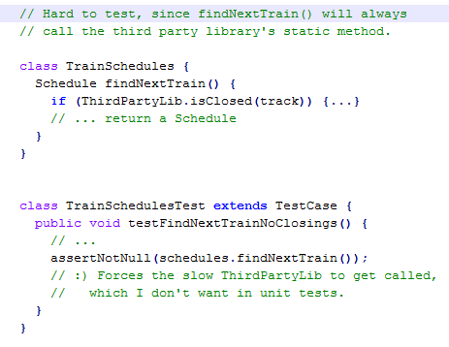
You are forced to execute the TrackStatusChecker‘s method even when you don’t want to, because it is locked in there with a static call.

Slide 48
Fix
Wrap the library in an injectable object of your own.
Then in your class, take the new LibraryWrapper as a dependency.

Slide 49
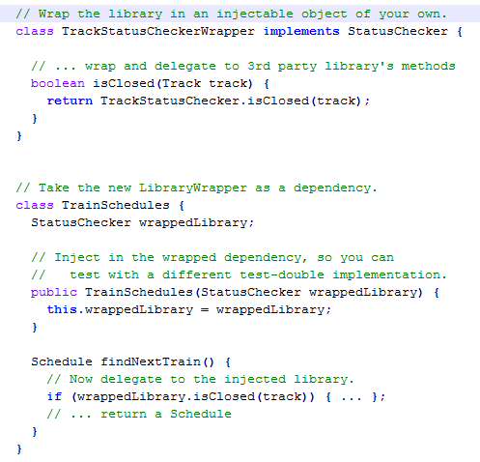

Slide 50
class TrainSchedulesTest extends TestCase {
public void testFindNextTrainNoClosings() {
StatusCheckerWrapper localWrapper =
new StubStatusCheckerWrapper();
TrainSchedules schedules = new TrainSchedules(localWrapper);
assertNotNull(schedules.findNextTrain());
// This works just as we wanted,
// allowing us to test the TrainSchedules in isolation.
}
}

